Slide 1


Lai Yen Ling
22/10/2022

Slide 2

Outline
Executive Summary
Introduction
Methodology
Results
Conclusion
Appendix

Slide 3
Executive Summary
Summary of methodologies - Data Collection & Data Wrangling Methodology - EDA and Interactive Visual Analytics Methodology - Predictive Analysis Methodology
Summary of all results - EDA with Visualization Results - EDA with SQL Results - Interactive Map with Folium Results - Plotly Dash Dashboard Results - Predictive Analysis Results

Slide 4
Introduction
Project background and context - Space X rocket launches are inexpensive, costing 62 millions dollars, much savings is due to Falcon 9 can reuse/recover the first stage. Other companies cost upwards of 165 million dollars each.
Problems you want to find answers - Predict if Space X Falcon 9 rocket will reuse the first stage as it land successfully.

Slide 5

Section 1

Slide 6
Methodology
Executive Summary
Data collection methodology:
Space X launch data from REST API & Web Scraping from Wiki Pages
Perform data wrangling
One Hot Encoding, Data Cleaning
Perform exploratory data analysis (EDA) using visualization and SQL
Perform interactive visual analytics using Folium and Plotly Dash
Perform predictive analysis using classification models
Building of LR, KNN, SVM and DT models & performance evaluation

Slide 7
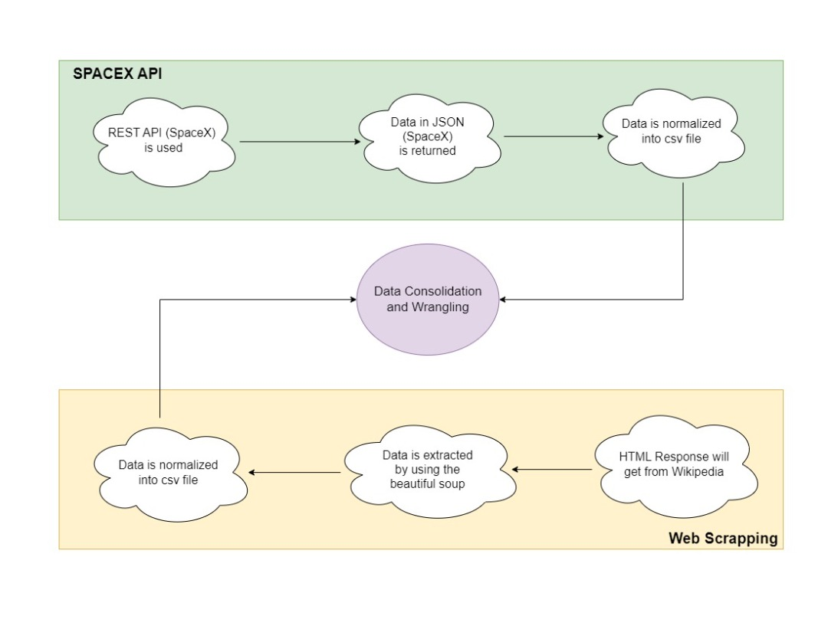
Data Collection
Work with the SpaceX launch data gathered from REST API
Data : launches, rocket used, payload delivered, launch specifications, landing specifications, and landing outcome
Goal : to predict whether SpaceX will attempt to land a rocket or not
API Endpoint : api.spacexdata.com/v4/launches/past
Calling the .json() method, convert the JSON to dataframe using json_normalize function.
Data Source available : web scraping some HTML tables that contain Falcon 9 launch record from the wiki pages using Beautiful Soup Package
Normalize the data into CSV files ready for wrangling

Slide 8
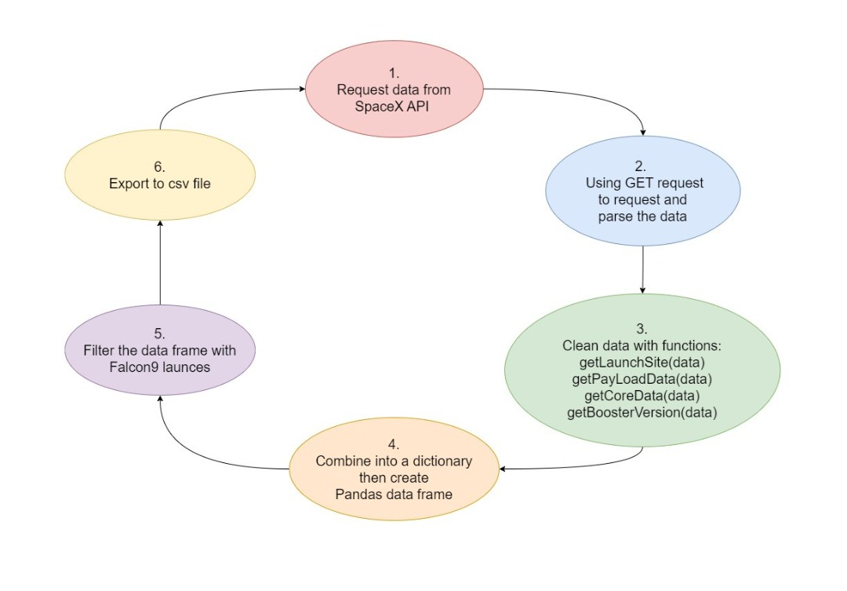
Data Collection – SpaceX API
Performing collection with SpaceX REST calls
https://github.com/krystallai1220/Applied-DS-Capstone/blob/4cb4efb8b8bc3ffd7c1bd8a84a9a08d536dbfa63/Assignment%201%20Jupyter-labs-spacex-data-collection-api.ipynb

Slide 9
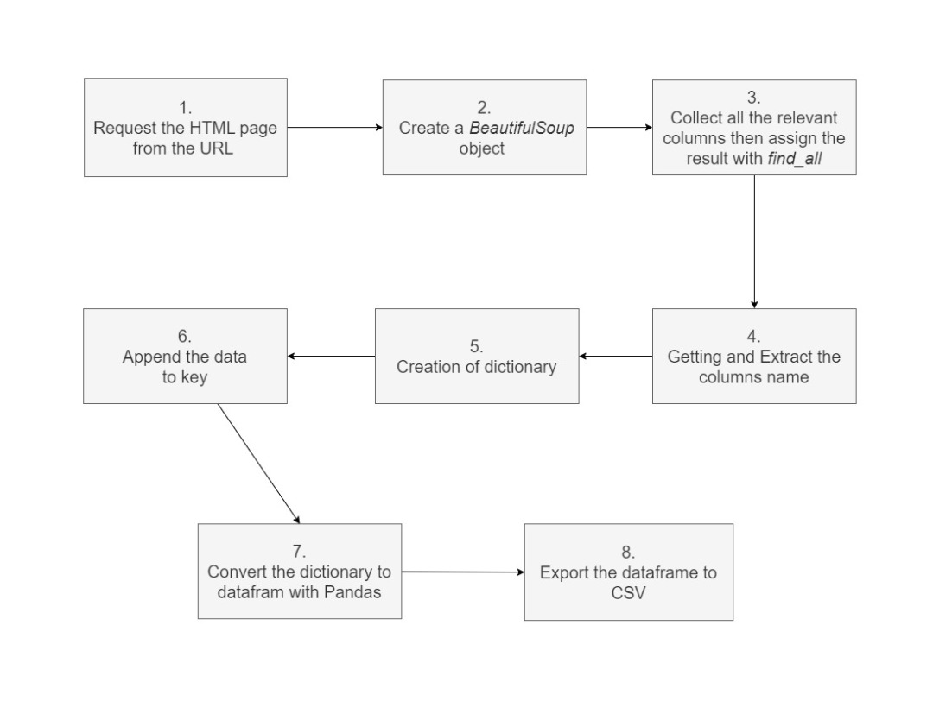
Data Collection - Scraping
Performing web scraping process from Wikipedia Page
https://github.com/krystallai1220/Applied-DS-Capstone/blob/4cb4efb8b8bc3ffd7c1bd8a84a9a08d536dbfa63/Assignment%202%20jupyter-labs-webscraping.ipynb

Slide 10
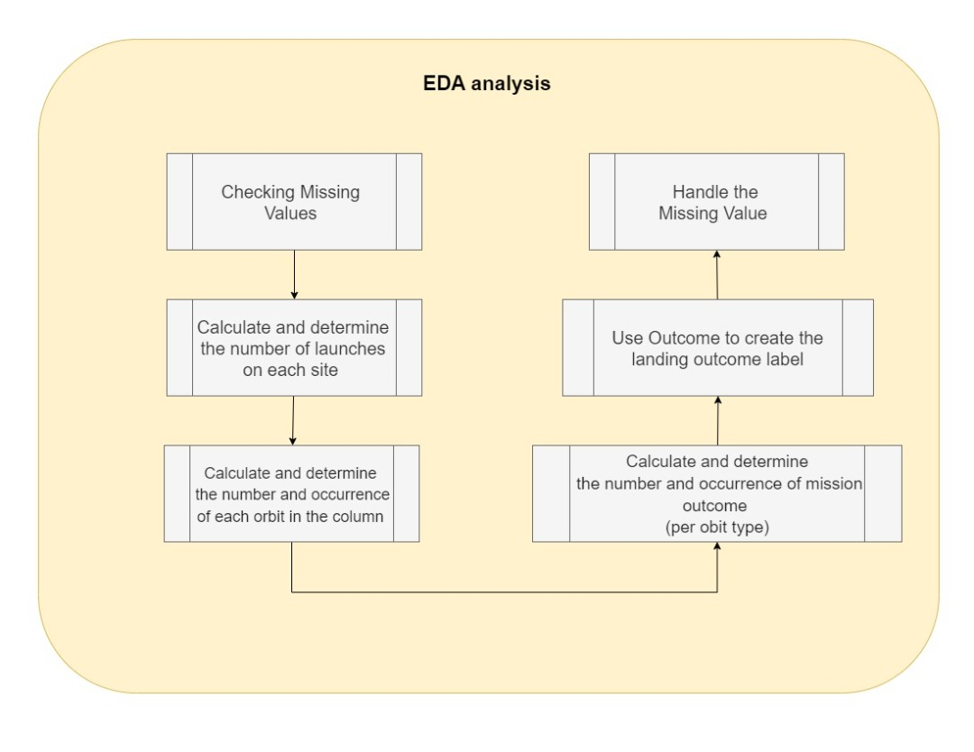
Data Wrangling
Process of Data Wrangling
https://github.com/krystallai1220/Applied-DS-Capstone/blob/4cb4efb8b8bc3ffd7c1bd8a84a9a08d536dbfa63/Assignment%203%20labs-jupyter-spacex-Data%20wrangling.ipynb

Slide 11
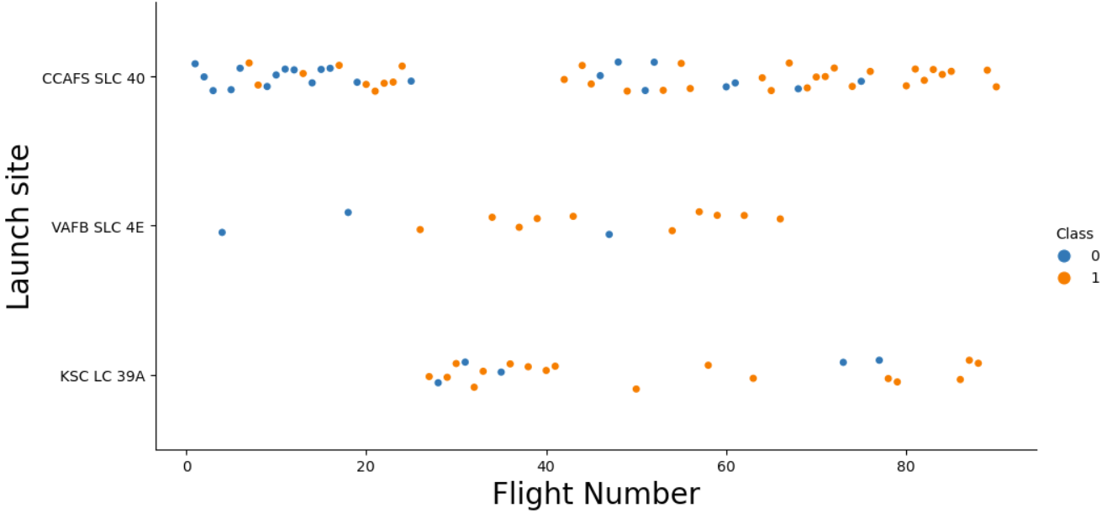
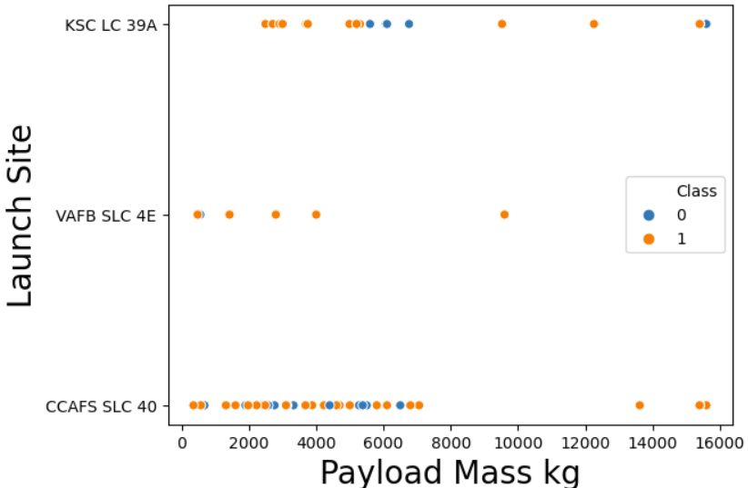
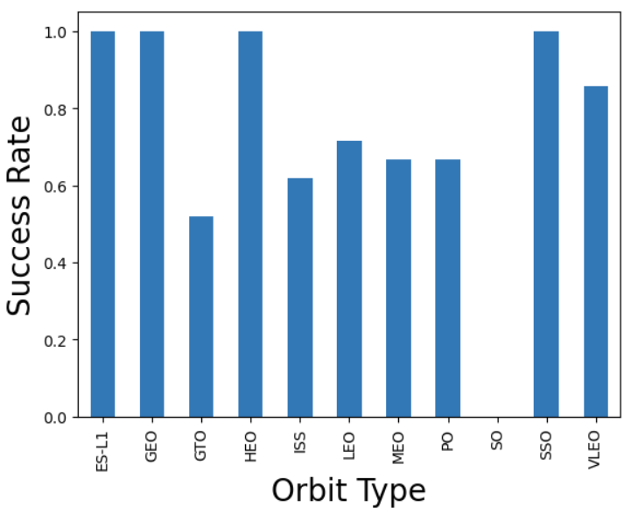
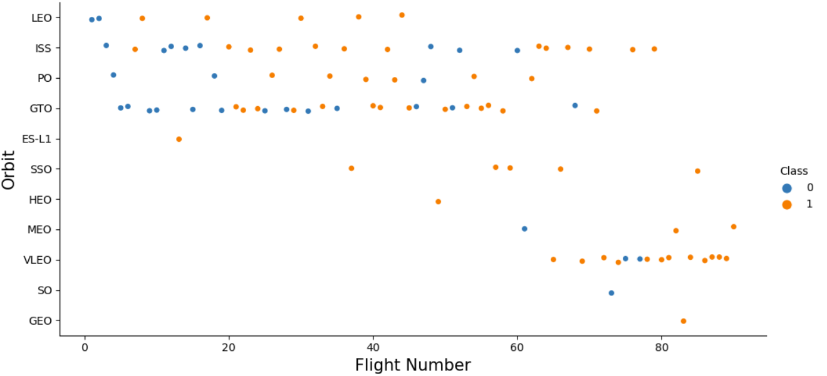
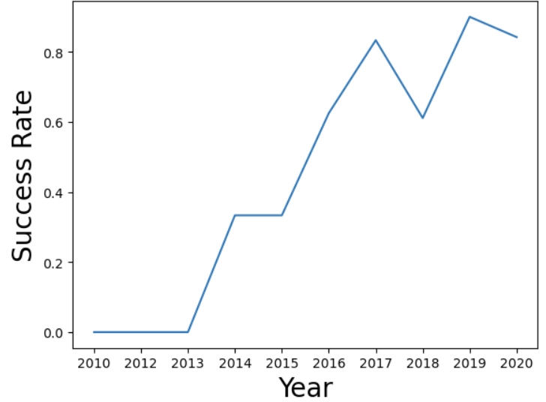
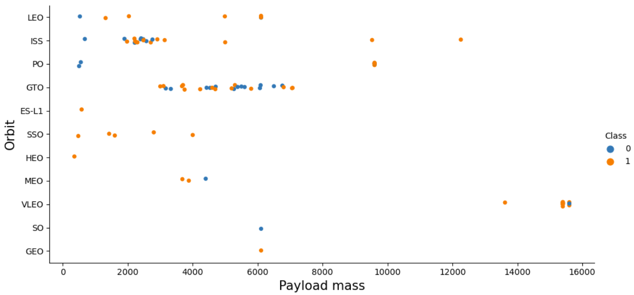
EDA with Data Visualization
Visualize the relationship between flight number and launch site
Visualize the relationship between payload and launch site
Visualize the relationship between success rate of each orbit type
Visualize the relationship between Flight Number and Orbit Type
Visualize the relationship between payload and orbit type
Visualize the launch success yearly trend
https://github.com/krystallai1220/Applied-DS-Capstone/blob/4cb4efb8b8bc3ffd7c1bd8a84a9a08d536dbfa63/Assignment%205%20jupyter-labs-eda-dataviz.ipynb

Slide 12
EDA with SQL
https://github.com/krystallai1220/Applied-DS-Capstone/blob/4cb4efb8b8bc3ffd7c1bd8a84a9a08d536dbfa63/Assignment%204%20jupyter-labs-eda-sql-coursera_sqllite.ipynb
SQL queries performed
Display the names of unique launch sites in the space mission
Display 5 records where launch sites begin with the string ‘CCA’
Display the total payload mass carried by boosters launched by NASA(CRS)
Display average payload mass carried by booster version F9 v1.1
List the date when the first successful landing outcome in ground pad was achieved
List the names of the boosters which have success in drone ship and have payload mass greater than 4000 but less than 6000
List the total number of successful and failure of mission outcomes
List the names of the booster versions which have carried the maximum payload mass
List the records which will display the month names, failure landing outcomes in drone ship, booster versions, launch site for the months in year 2015
Rank the count of successful landing outcomes between the date 04-06-2010 and 20-03-2017 in descending order

Slide 13
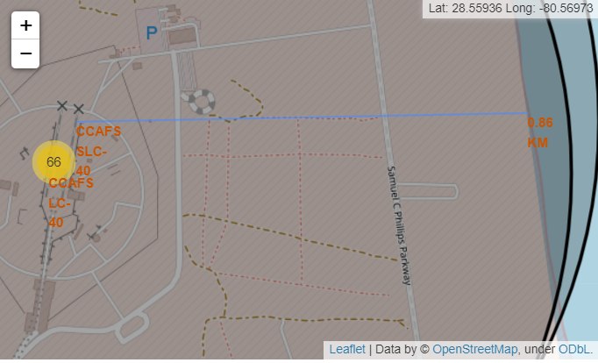
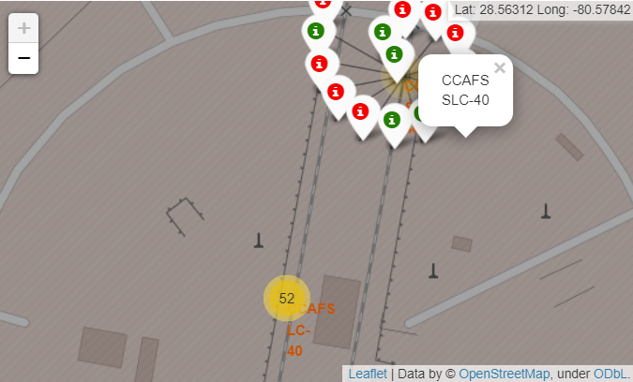
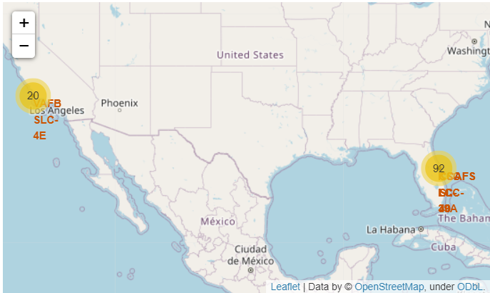
Build an Interactive Map with Folium
Map objects such as markers, circles, lines, etc. you created and added to a folium map
https://github.com/krystallai1220/Applied-DS-Capstone/blob/4cb4efb8b8bc3ffd7c1bd8a84a9a08d536dbfa63/Assignment%206%20lab_jupyter_launch_site_location.ipynb

Slide 14
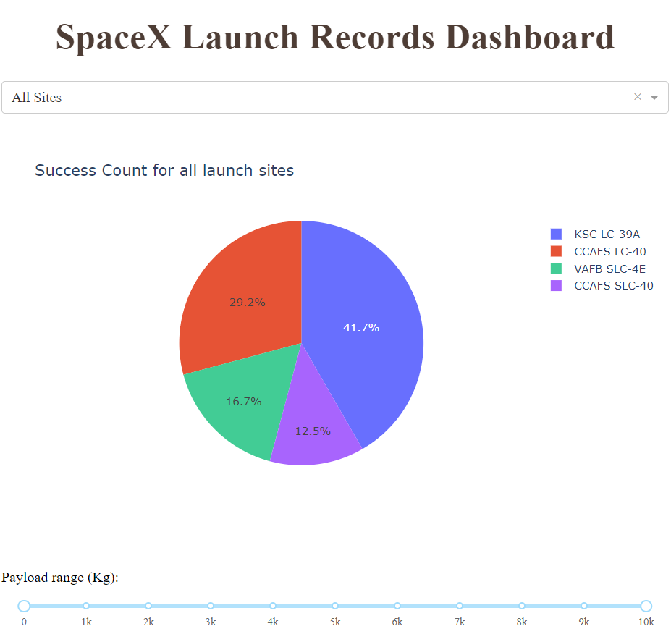
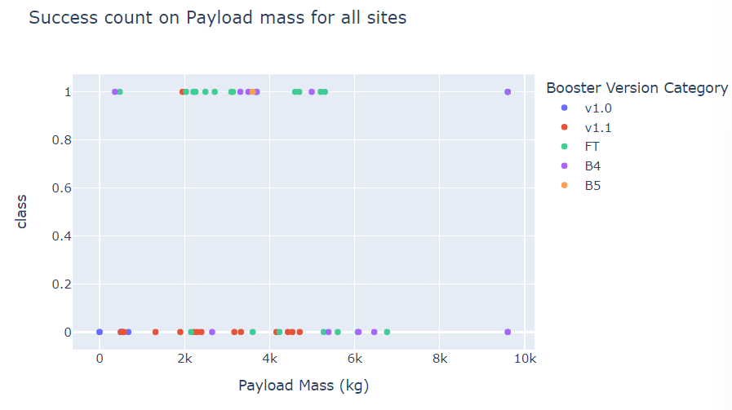
Build a Dashboard with Plotly Dash
Dropdown list of launch site
Pie Chart to show the total successful launch
Scatter chart to show the correlation between the payload and launch success
https://github.com/krystallai1220/Applied-DS-Capstone/blob/d63d1a1014014f56f7b9c63146ec7eb6458854e2/Assignment%207%20spacex_dash_app.py
Slider to select the payload range

Slide 15
Predictive Analysis (Classification)
Developing the Model - Standardize the data - Splitting the data into training and test dataset - Build Grid Search CV model and fit the data
Model Performance Evaluation - Evaluate the accuracies - Plotting the confusion matrix - Visualizing the results
Select the Optimal Model - Find the best hyperparameters for the models - Choose the best model with the highest accuracy
https://github.com/krystallai1220/Applied-DS-Capstone/blob/3438f7413f050a962bb2b1382cecc3e81479fc05/Assignment%208%20SpaceX_Machine%20Learning%20Prediction_Part_5.ipynb

Slide 16
Results
KSC LC 39A has the most successful launches from all the sites.
Orbit GEO, HEO, SSO, ES L1 has the best success rate.
Low weighted payloads have higher success rate than the heavier payload.
All the models perform similarly good, but Decision Tree has the best performance in terms of the prediction accuracy of the dataset.

Slide 17

Section 2

Slide 18
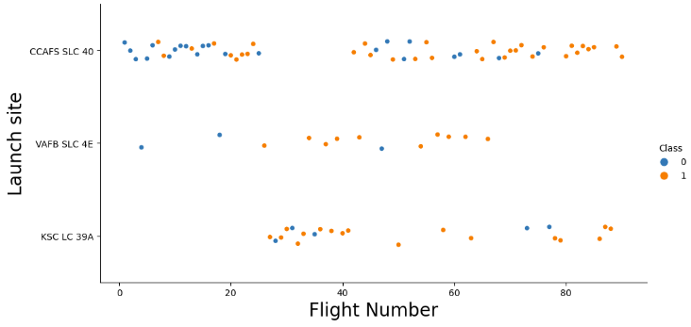
Flight Number vs. Launch Site
CCAFS LC-40 has a success rate of 60% but if the flight number is above 80, the success rate is 100%.

Slide 19
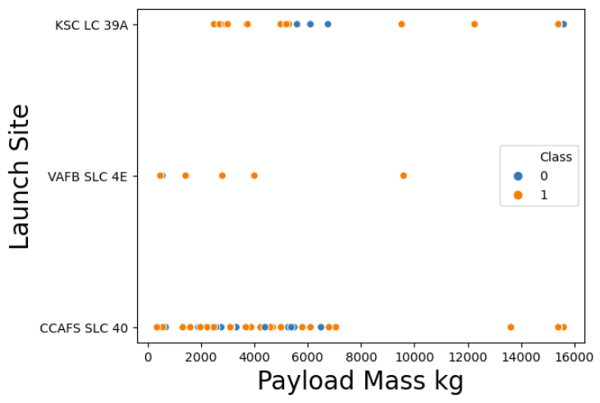
Payload vs. Launch Site
In the payload vs launch site scatter point chart, for the VAFB-SLC launch site, there are no rockets launched for heavy payload mass (greater than 10000).

Slide 20
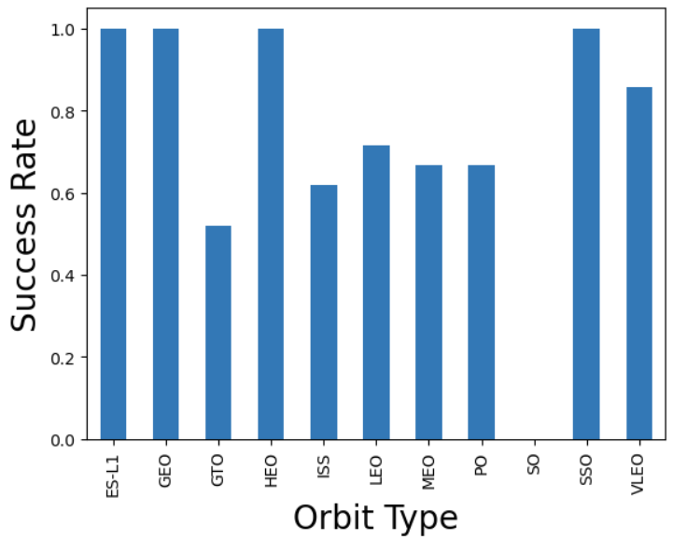
Success Rate vs. Orbit Type
Orbit ES-L1, GEO, HEO, and SSO have the same highest success rate.

Slide 21
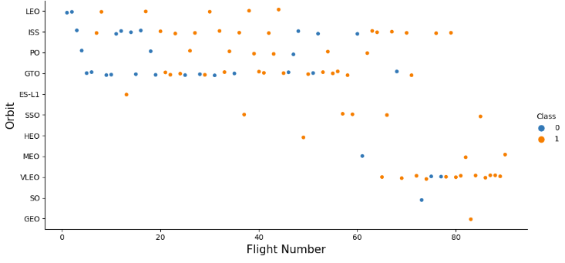
Flight Number vs. Orbit Type
In the LEO Orbit the Success appears related to the number of flights, on the other hand, there seems to be no relationship between flight number when in GTO orbit.

Slide 22
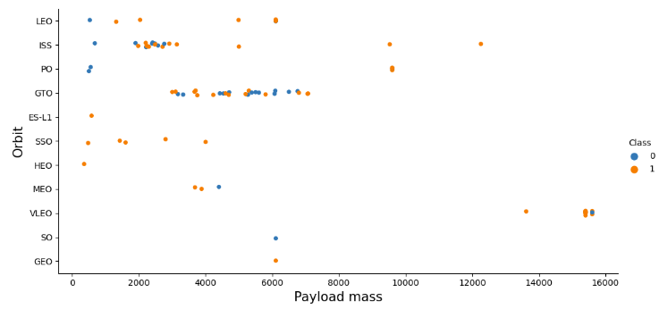
Payload vs. Orbit Type
With heavy payloads the successful landing or positive landing rate are more for Polar, LEO, and ISS. However, for GTO we cannot distinguish this well as both positive landing rate and negative landing (unsuccessful mission) are both there.

Slide 23
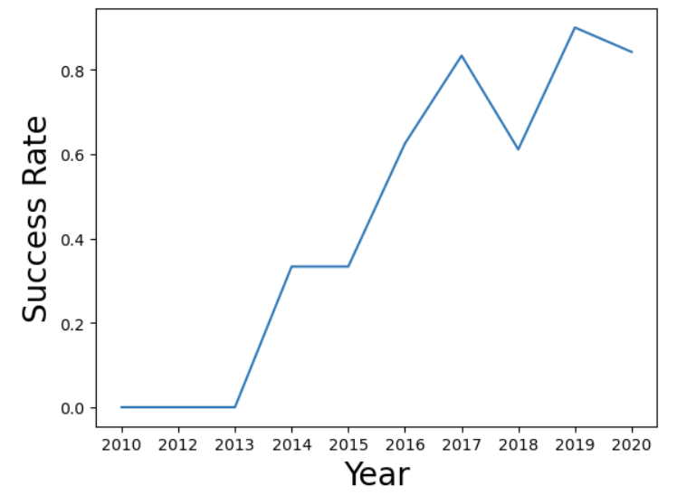
Launch Success Yearly Trend
The success rate since 2013 kept increasing till 2020.

Slide 24
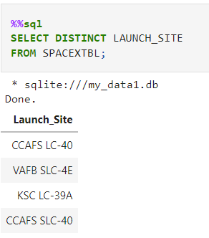
All Launch Site Names
Here shows the launch site names

Slide 25
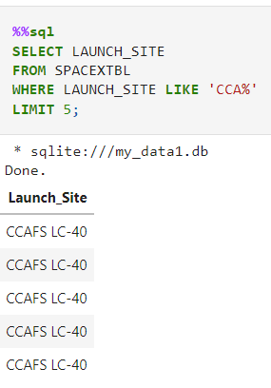
Launch Site Names Begin with 'CCA'
Showing 5 records launch sites begin with `CCA`

Slide 26
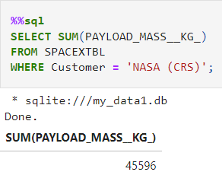
Total Payload Mass
Calculating the total payload carried by boosters from NASA (CRS) which is 45596kg.

Slide 27
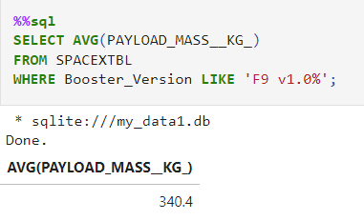
Average Payload Mass by F9 v1.1
Calculating the average payload mass carried by booster version F9 v1.1 which is 340.4kg

Slide 28
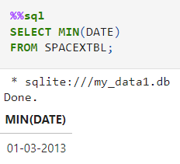
First Successful Ground Landing Date
Found the dates of the first successful landing outcome on ground pad which is 01-03-2013 using MIN function

Slide 29
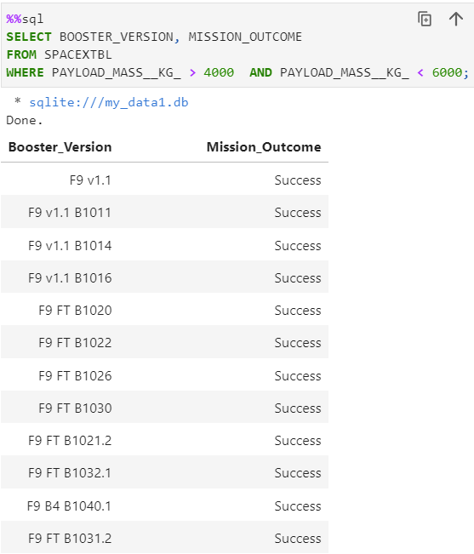
Successful Drone Ship Landing with Payload between 4000 and 6000
List the names of boosters which have successfully landed on drone ship and had payload mass greater than 4000 but less than 6000

Slide 30
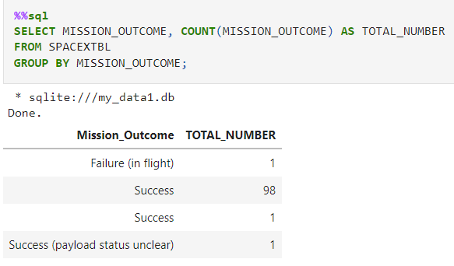
Total Number of Successful and Failure Mission Outcomes
Calculating the total number of successful and failure mission outcomes

Slide 31
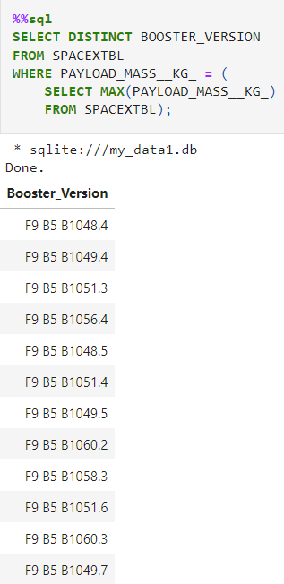
Boosters Carried Maximum Payload
Listing the names of the booster which have carried the maximum payload mass

Slide 32
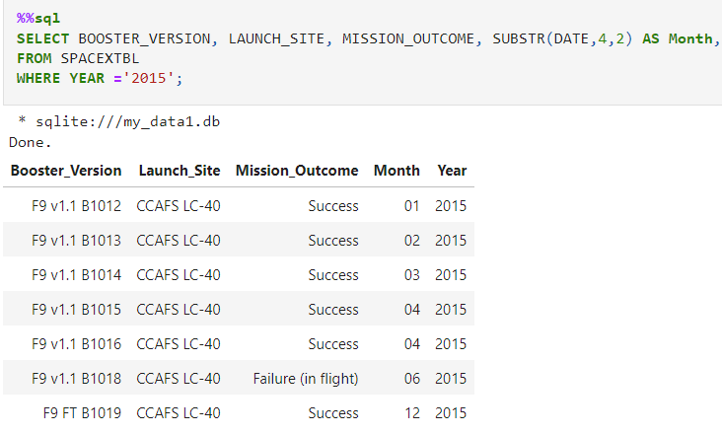
2015 Launch Records
Listing the failed landing outcomes in drone ship, their booster versions, and launch site names for in year 2015

Slide 33
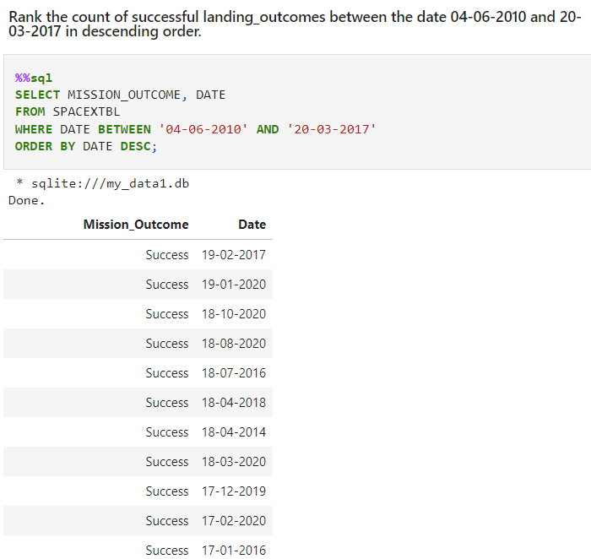
Rank Landing Outcomes Between 2010-06-04 and 2017-03-20
Ranking the count of landing outcomes (such as Failure (drone ship) or Success (ground pad)) between the date 2010-06-04 and 2017-03-20, in descending order

Slide 34

Section 3

Slide 35
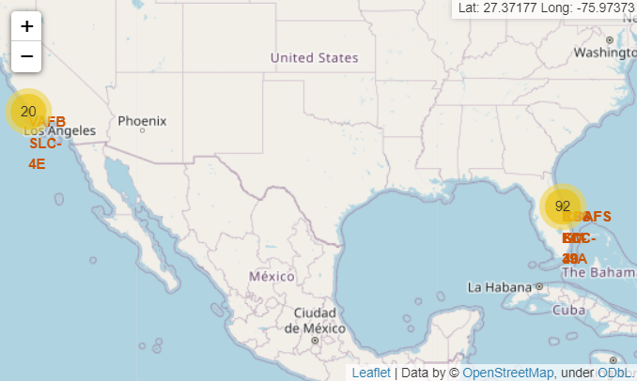
Marking of the site launches on the map
Visualizing the launch sites on a map showing the proximity of the launch sites to the equator and the coast, as it takes less fuel to get into space from the equator, and due to safety reasons.

Slide 36
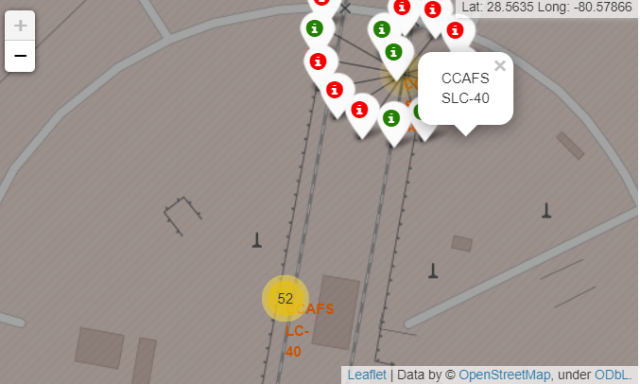
Showing the marker clusters
This color label mark the success and failed site launches, we can easily identify which launch sites have relatively high success rate

Slide 37
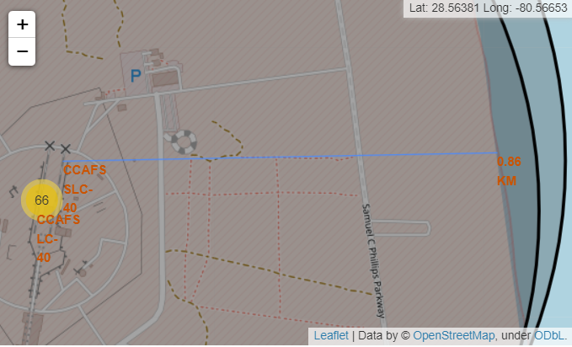
Finding the closest coastline to the launch site
The distance between the coastline point and the launch site is 0.8627671182499878km and it is visualized using the polyline.
distance_highway = 0.5834695366934144 km
Close proximity to allow easily transport required people and property
distance_railroad = 1.2845344718142522 km
Close proximity to allow transport for heavy cargo
distance_city =
51.43416999517233 km
Not Close proximity to minimized danger to population dense area.

Slide 38

Section 4

Slide 39
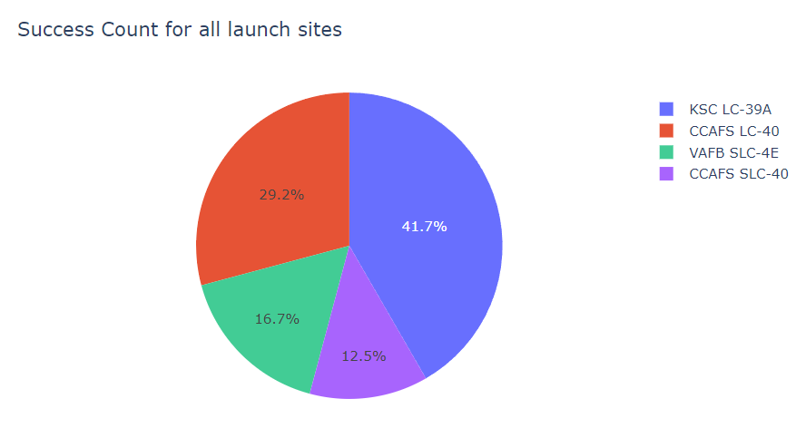
Pie Chart – Success Launch Count for Sites
KSC LC-39A has the most successful launch count from all the sites with the percentage of 41.7%

Slide 40
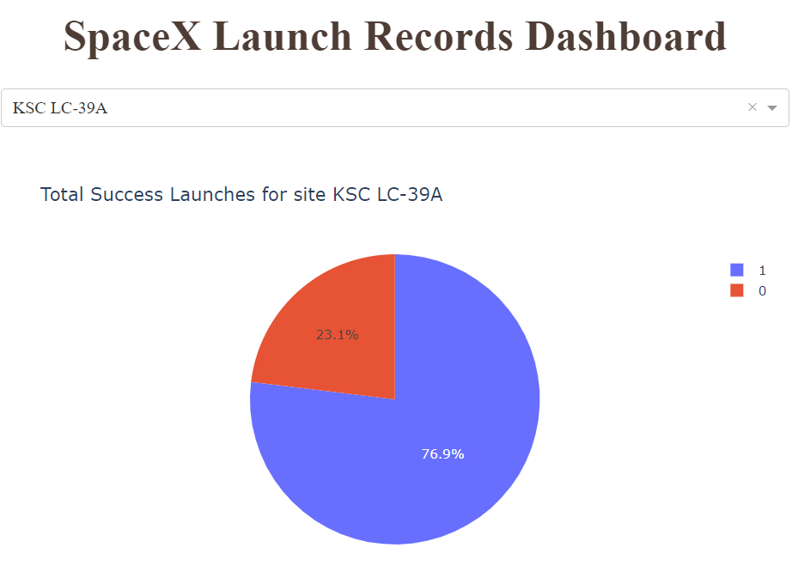
Pie Chart – Success Rate for KSC LC-39A Site
For the KSC LC-39A site, there are 76.9% are success rate, whereas 23.1% are failure rate.

Slide 41
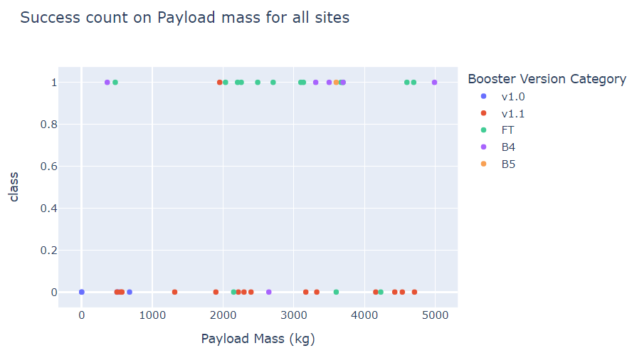
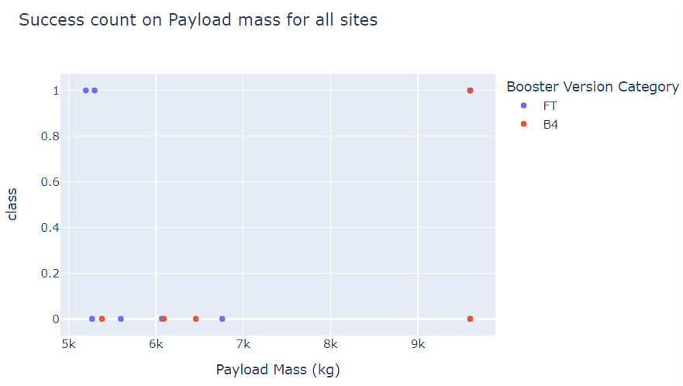
Scatter Plot – Payload vs Launch Outcome
Low payload range (0-4000kg)
High payload range (4000-10000kg)
Low payload range has the higher success rate than the high payload range for all sites.

Slide 42

Section 5

Slide 43
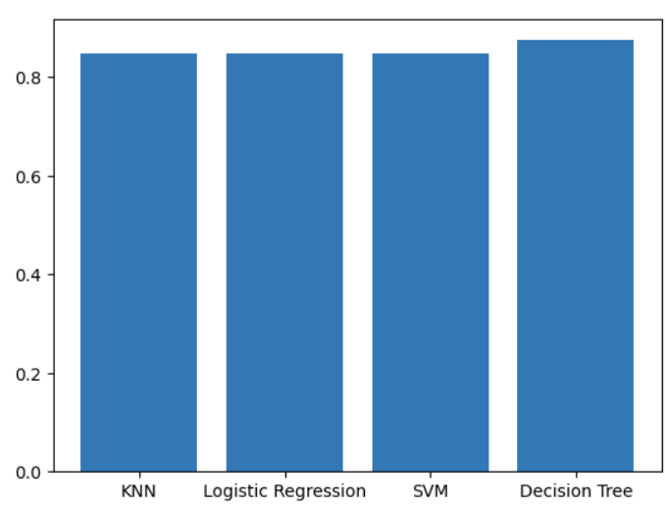
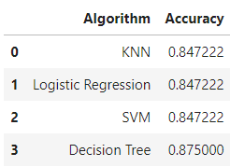
Classification Accuracy
The method which performs best is the Decision Tree with a score of 0.875

Slide 44
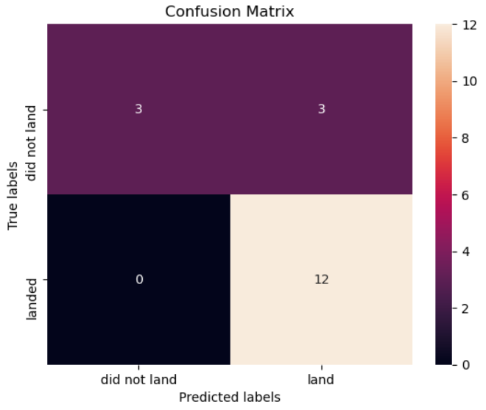
Confusion Matrix
Confusion matrix show the performance of the model, which have 12 correct predicted labels for land and in actual landed, and 3 correct predicted labels for did not land. However, there are only 3 predicted land but in actual did not land.

Slide 45
Conclusions
KSC LC 39A has the most successful launches from all the sites.
Orbit GEO, HEO, SSO, ES L1 has the best success rate.
Low weighted payloads have higher success rate than the heavier payload.
All the models perform similarly good, but Decision Tree has the best performance in terms of the prediction accuracy of the dataset.

Slide 46


